Slide 1
12
Alica Jenčová

Slide 2
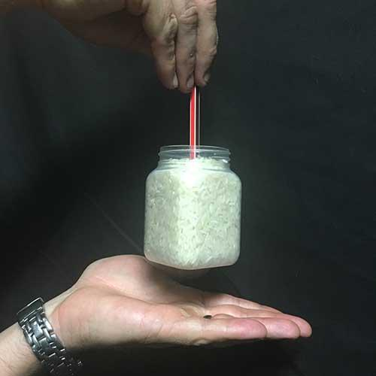
Rice Kettlebells
Take a vessel and pour some granular material into it, for example, rice. If you dip e.g. a spoon into it, then at a certain depth of immersion, you can lift the vessel and contents by holding the spoon.
Explain this phenomenon
and explore the relevant
parameters of the system.

Slide 3
OVERVIEW
1
Phenomenon demonstration
Various conditions examined
2
Basic explanation
Friction and pressure
3
Theory
Pressure and friction, arrangement of granules
4
Experimental setup
Relevant parameters, methodology of experiments
Experimental results
5
Graphs, comparison with theory
Notes:
Very quickly

Slide 4
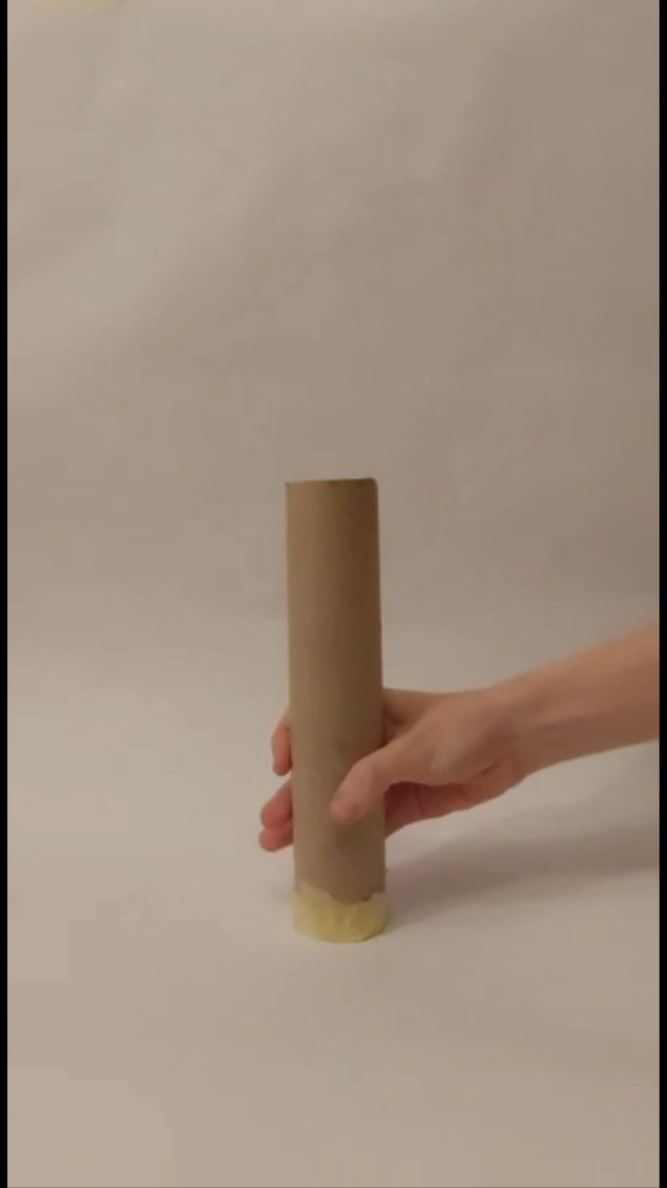
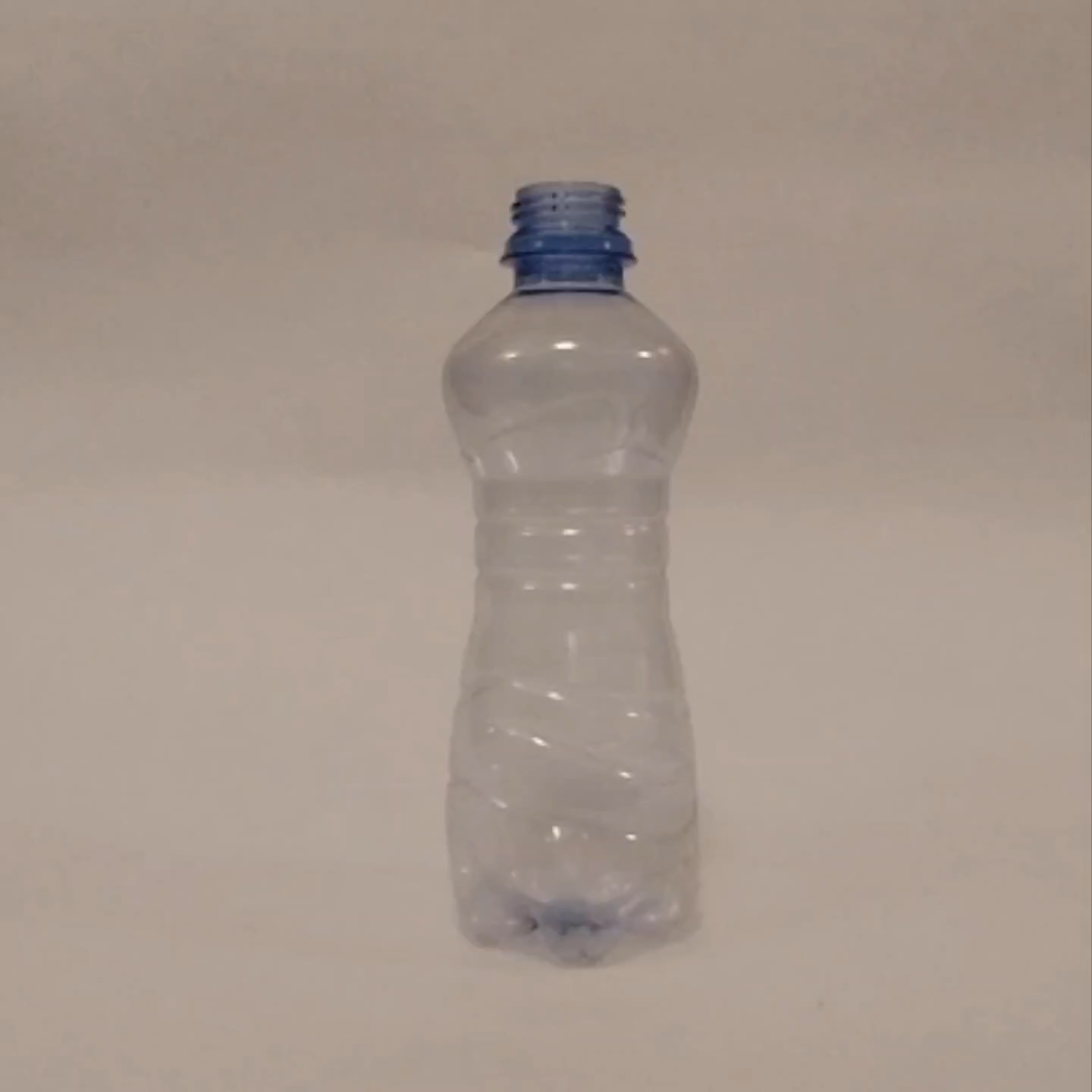
Phenomenon demonstration
Rice and millet
Plastic vessel
Cardboard vessel
Phenomenon
Explanation
Theory
Setup
Graphs
Notes:
Shortly the experimental methodology
Take a vessel and pour some granular material into it, for example, rice. If you dip e.g. a spoon into it, then at a certain depth of immersion, you can lift the vessel and contents by holding the spoon.
Explain this phenomenon and explore the relevant parameters of the system.

Slide 5
Basic explanation

Slide 6
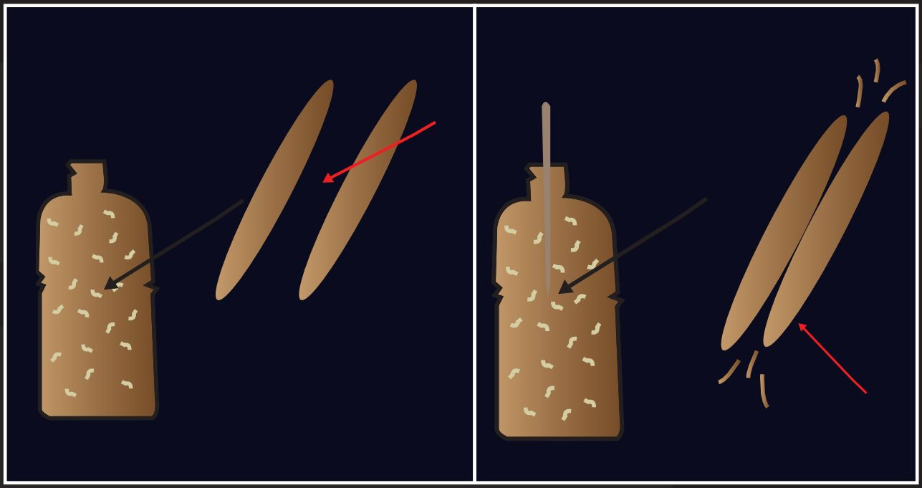
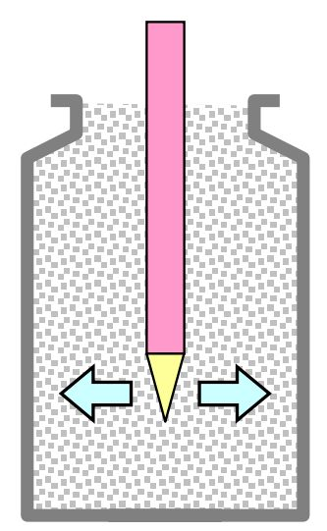

Friction and Pressure
Grains, vessel and stick interact with each other
Pressure increases friction force
Phenomenon
Explanation
Theory
Setup
Graphs
Notes:
Detailed, demonstrative, deep, comprehensible, must show physical insight
Interaction between grains, vessel, stick = friction
We put a stick inside – it’s quite hard to put it in – pressure force is increased => friction force is increased

Slide 7
Further theory
Detailed investigation of phenomenon

Slide 8
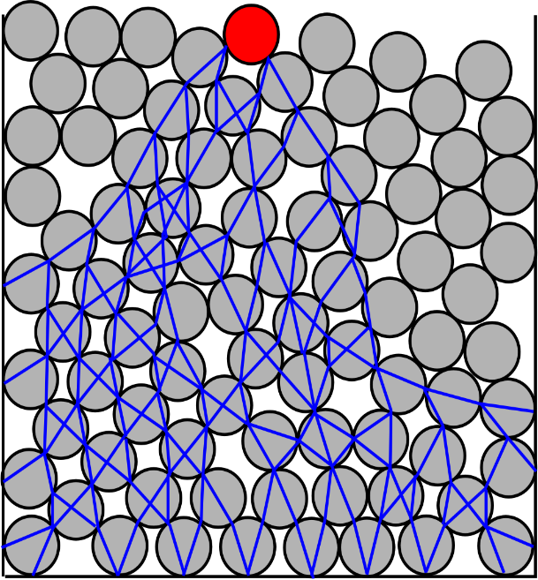
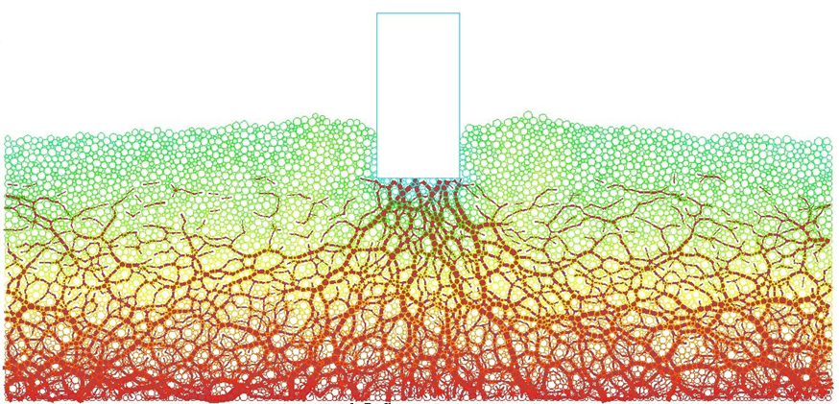
Force chains
Visualization of intermolecular forces
Top grains
Outer pressure
Claudia Cogné, Emmanuel Bellenger, Mohamed Guessasma, Christine Pélegris, Nabil Ferguen: A numerical model for predicting effective thermal conductivities of alumina/Al composites
https://en.wikipedia.org/wiki/Force_chain#cite_ref-Kondic2012_2-0
Daniel N. Wilke: Traction chain networks: Insights beyond force chain networks for non-spherical particle systems
Kondic, L.; Goullet, A.; O'Hern, C. S.; Kramar, M.; Mischaikow, K.; Behringer, R. P. (2012). "Topology of force networks in compressed granular media". EPL. 97 (5): 54001.
Phenomenon
Explanation
Theory
Setup
Graphs
Notes:
- Force chains visualize intermolecular forces
- Emerging by the complex interaction of individual grains under stress exerted on the granular material

Slide 9
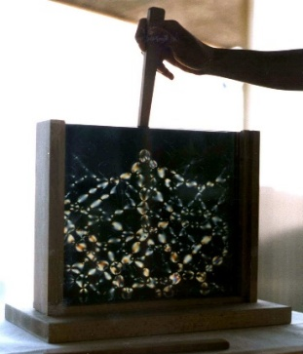
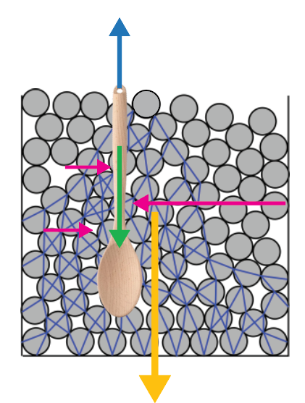
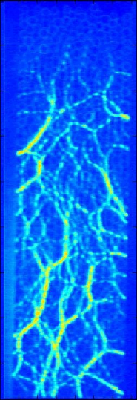
Forces analysis
Description of ideal conditions
Pull force
Gravitational force
Separation of vessel and stick
Pressure force
Friction force
Stick stays in the vessel
Jan Kleinert: Simulating Granular Material using Nonsmooth Time-Stepping and a Matrix-free Interior Point Method
Peters, J. F.; Muthuswamy, M.; Wibowo, J.; Tordesillas, A. (2005). "Characterization of force chains in granular material". Physical Review E. 72 (4 Pt 1): 041307.
Tomaso Aste, Tiziana Di Matteo, Enrico Galleani d´Agliano: Stress transmission in granular materials
https://web.physics.ucsb.edu/~complex/research/granular.html#ForceNumber
Phenomenon
Explanation
Theory
Setup
Graphs
Notes:
- Force chains visualize intermolecular forces
Emerging by the complex interaction of individual grains under stress exerted on the granular material
Best conditions:
Wide stick with big surface area
A lot of granular material
Deep immersion
Lightweight vessel
Rough surface of components
Large grain density

Slide 10
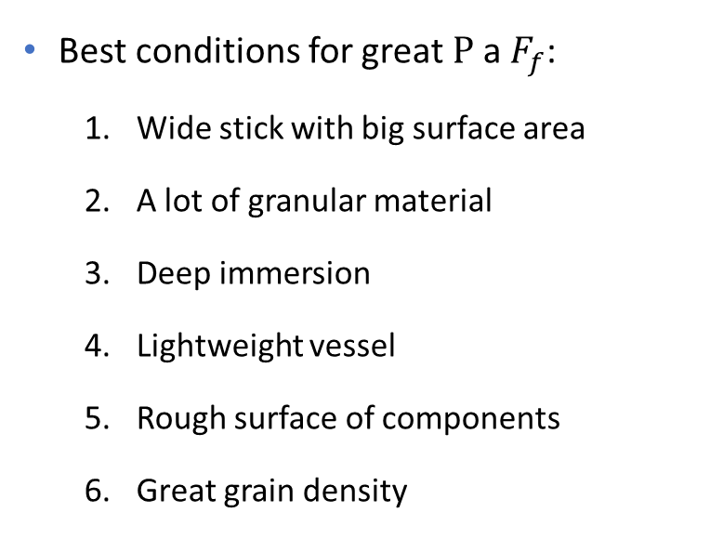
Forces analysis
Description of ideal conditions
Phenomenon
Explanation
Theory
Setup
Graphs
Notes:
- Force chains visualize intermolecular forces
Emerging by the complex interaction of individual grains under stress exerted on the granular material
Best conditions:
Wide stick with big surface area
A lot of granular material
Deep immersion
Lightweight vessel
Rough surface of components
Large grain density

Slide 11
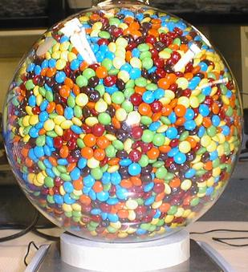
RCP – Random close packing
A parameter determining the maximum density of randomly arranged solid objects
The more we shake » the greater the density (e.g. during transportation)
Not possible infinitely, limit = RCP
Effect of object shape:
  polydisperse grains can be arbitrarily close to 1
  (relatively) monodisperse grains – shape plays a big role
  (RCP of spheres = 0,64; RCP of M&M´s candy = 0,68)
https://en.wikipedia.org/wiki/Random_close_pack

Slide 12
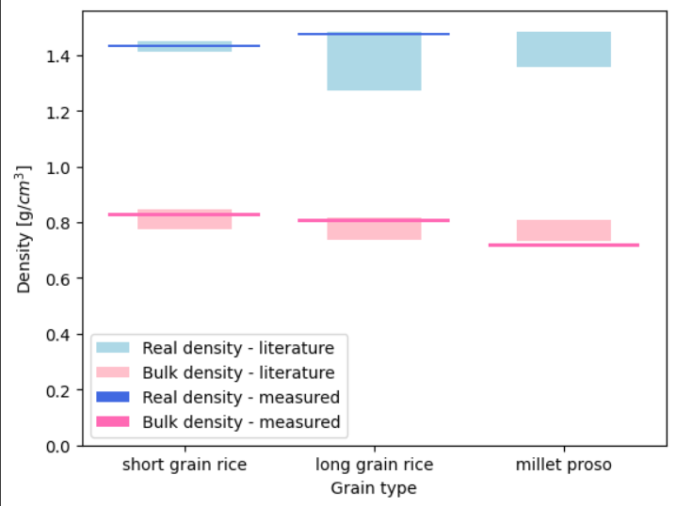


Random close packing
RCP coefficient
Sources of literature values can be found in the appendix
Phenomenon
Explanation
Theory
Setup
Graphs
Notes:
WE USED SEVERAL SOURCES AND WERE UNABLE TO CITE THEM PROPERLY ON ONE SLIDE.
A parameter determining the maximum density of randomly arranged solid objects
The more we shake » the grater the density (e.g. during transportation)
Not possible infinitely, limit = RCP
Effect of object shape:
polydisperse grains can be arbitrarily close to 1
(relatively) monodisperse grains – shape plays a big role
(RCP of spheres = 0,64; RCP of M&M´s candy = 0,68)
Deviation of our measurements:
- Measuring cylinder –» deviation 0,5 ml
- Weighting scale –» deviation 0,005 g

Slide 13
RCP of several granular materials
Type of material | Density type | Data from scientific research |  | Data from my experiments
Short grain rice |  | 1 | 2
 | Real density [g/ml] | 1,41256 | 1,452 | 1,42857
 | Bulk density [g/ml] | 0,798 | 0,777 – 0,847 | 0,8333
Long grain rice |  | 3
 | Real density [g/ml] | 1,27081 – 1,48442 |  | 1,481
 | Bulk density [g/ml] | 0,73649 – 0,81785 |  | 0,812
Millet proso |  | 4 | 5
 | Real density [g/ml] | - | 0,1356192 – 0,148497 | -
 | Bulk density [g/ml] | 0,76549 – 0,80967 | 0,731414 – 0,756835 | 0,723
Measuring cylinder –» deviation 0,5 ml
Weighting scale –» deviation 0,005 g

Slide 14
Experimental setup

Slide 15
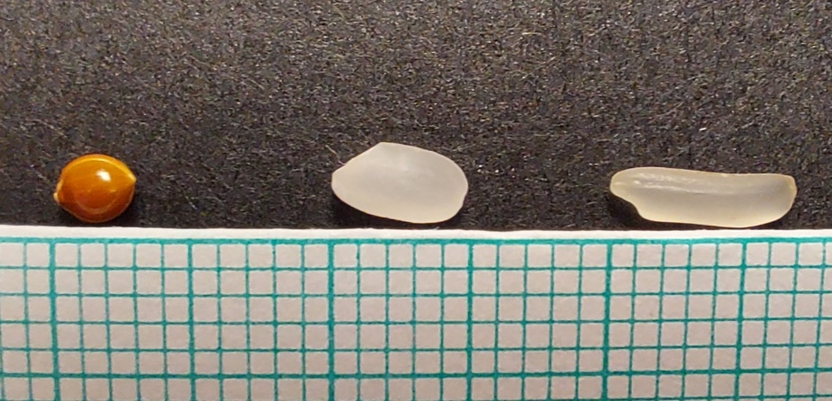
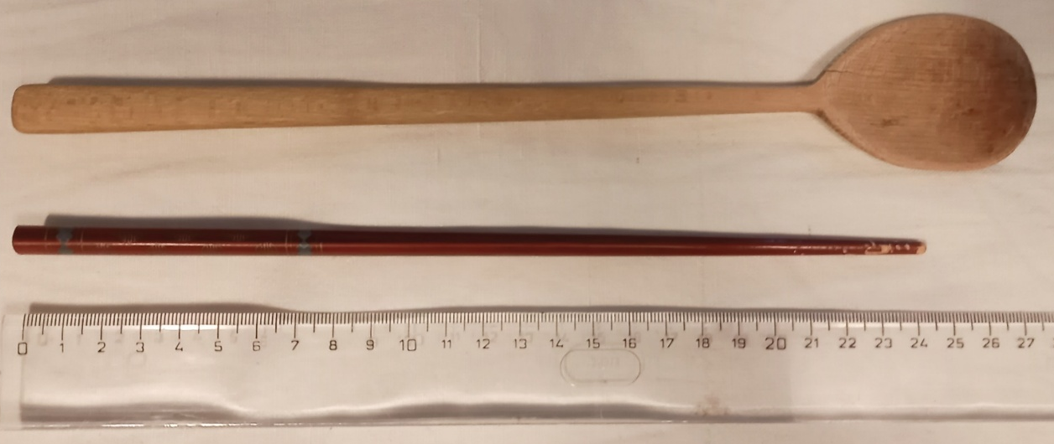
Grains and sticks used
Apparatus description
Millet proso
Short grain rice
Long grain rice
Various shapes and materials were examined
Phenomenon
Explanation
Theory
Setup
Graphs

Slide 16
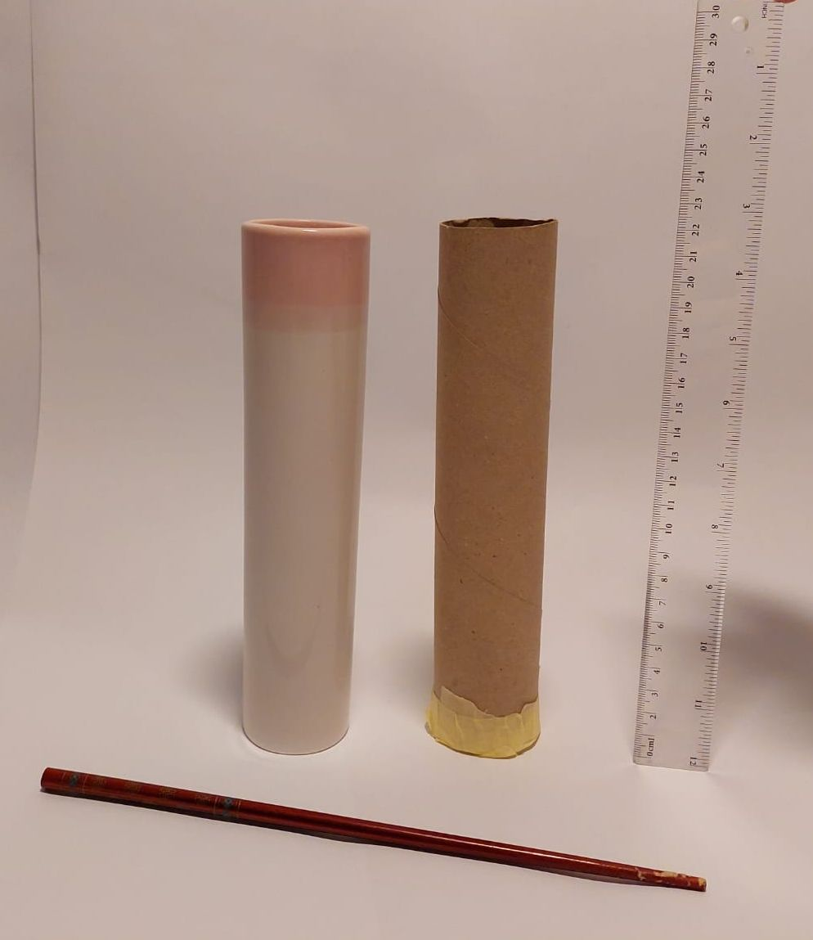
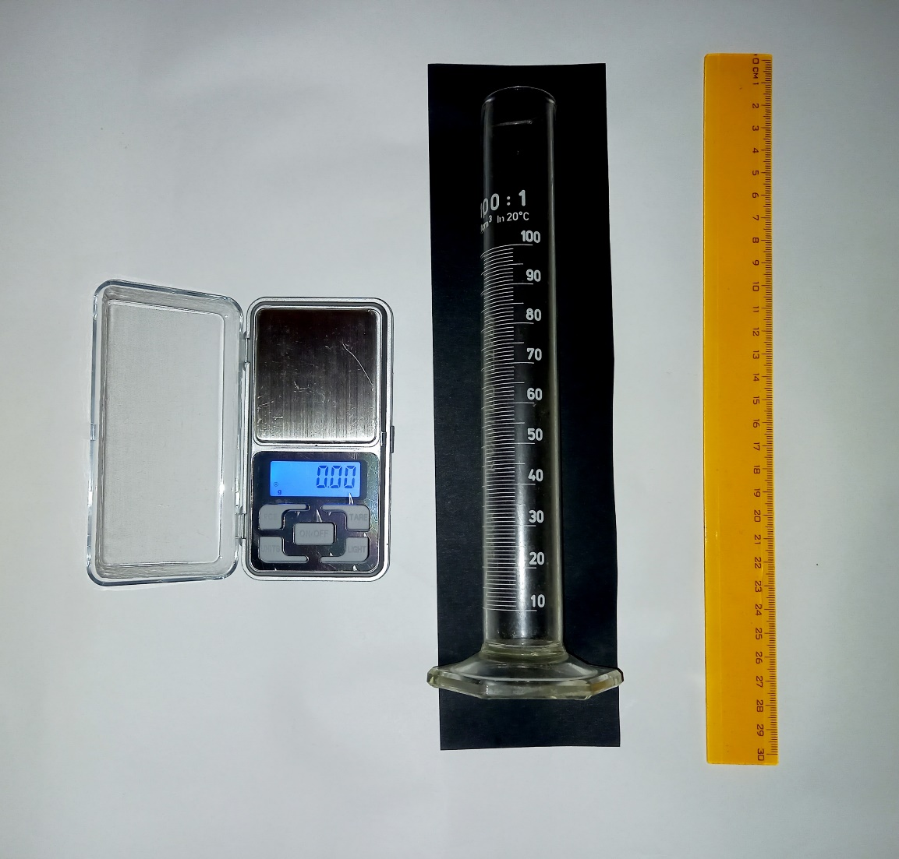
Vessels and measuring tools
Apparatus description
Focus on precision
Various weights, widths and heights
Phenomenon
Explanation
Theory
Setup
Graphs
Notes:
- 7 different vessels
(by weight, width and height)
- Weighting scale
- Ruler
- Measuring cylinder

Slide 17
Relevant parameters
Granular material
Vessel
Spoon
Shape
Mass
Shape
Surface
Surface
Surface
Amount
Diameter
Depth of immersion
Spot of immersion

Slide 18
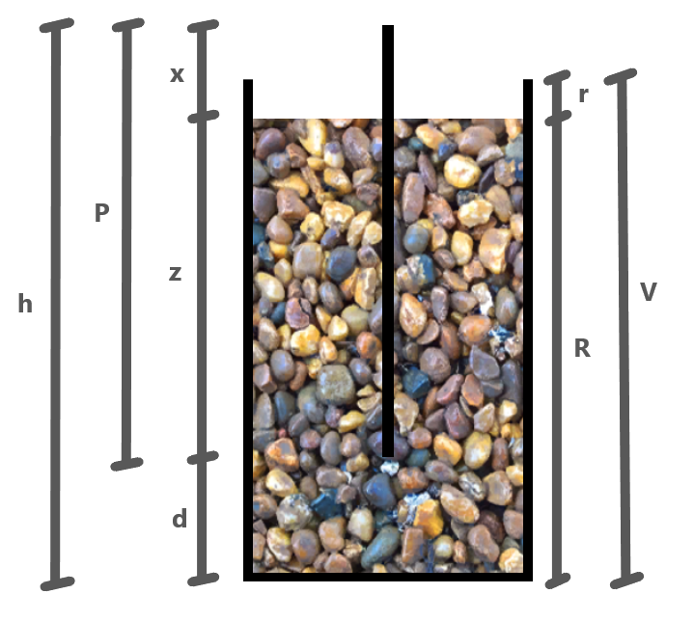
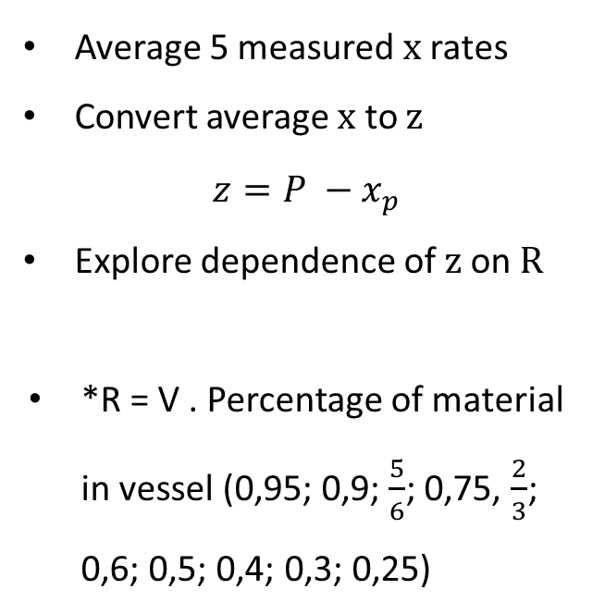
Methods of processing results

Slide 19
Methods of obtaining results (RP)
Determination of amounts of granular material
Pouring material into containers while continuously tapping and measuring the height of the material
Finding the lower limit by repeatedly immersing the stick
Repetition at several heights of material and different containers
Processing and averaging results
Processing into graphs

Slide 20
Experimental results
Notes:
Succesful lifting at least 3 seconds in the air
I always shook the vessel to get to the RCP

Slide 21
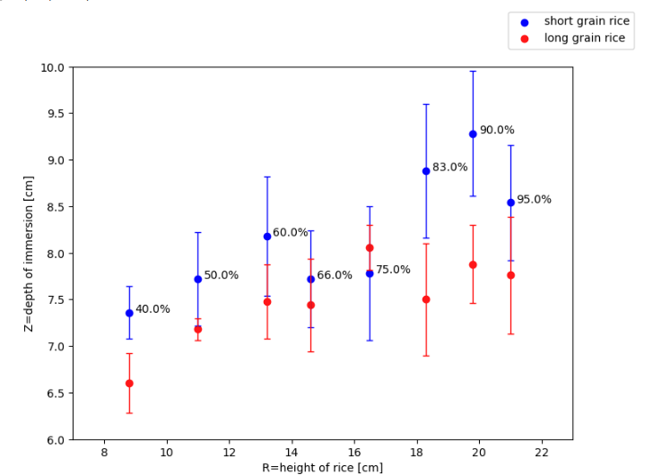

Researched parameter: shape of grains
Short grain rice:
  Diameter: ca. 5 mm
Long grain rice:
  Diameter: ca. 7 mm

Slide 22

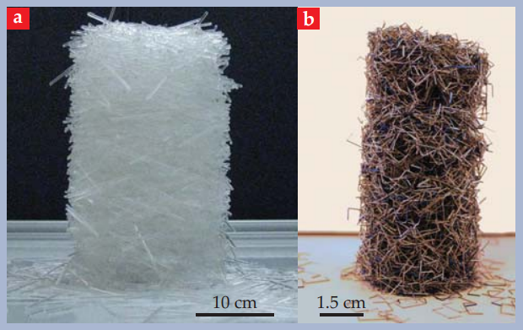

Grain shape
Parameters of granular material
Short grain rice
Geometrical cohesion observed
Long grain rice
Franklin, S. V. (2012). Geometric cohesion in granular materials. Physics Today, 65(9), 70–71. doi:10.1063/pt.3.1726
Phenomenon
Explanation
Theory
Setup
Graphs

Slide 23
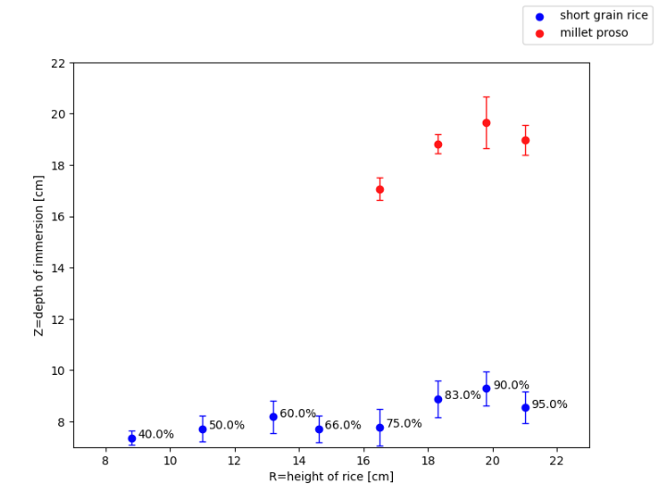
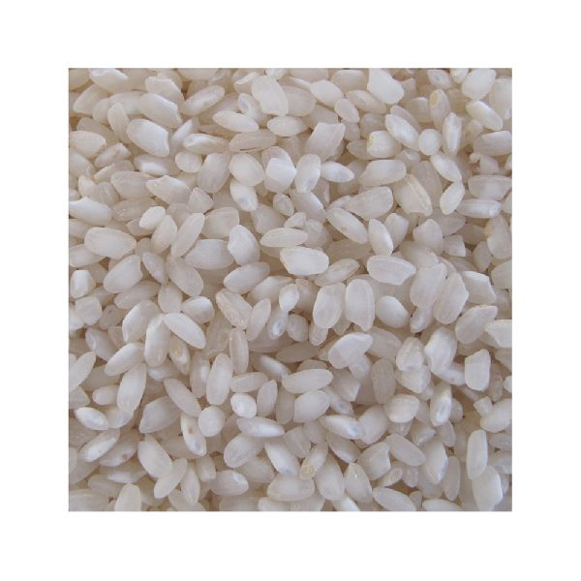
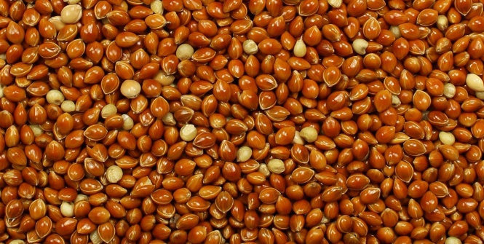
Researched parameter: surface of grains
Short grain rice:
  Surface: bumpy
Millet proso:
  Surface: smooth

Slide 24
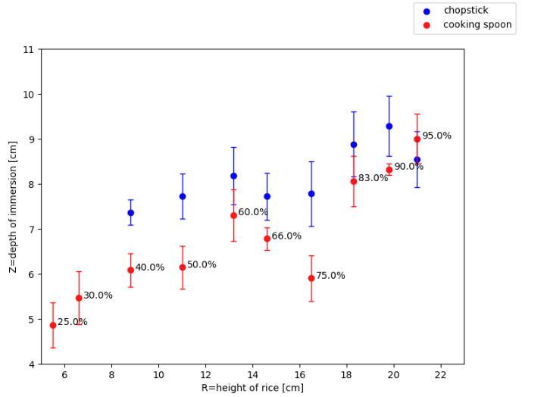

Researched parameter: spoon shape
Cooking spoon:
  Length: 25 cm
  Width: 6 – 36 mm
Chopstick:
  Length: 24,4 cm
  Width: 3 – 7 mm

Slide 25
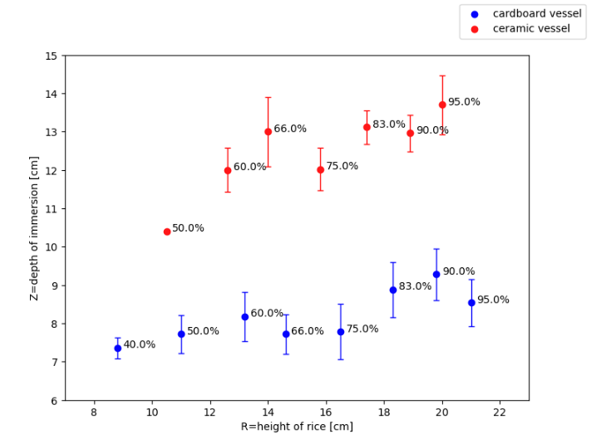

Researched parameter: weight of vessel
Ceramic vessel:
  Weight: 310 g
  Height: 21 cm
  Diameter: 4,2 cm
Cardboard vessel:
  Weight: 14 g
  Height: 22 cm
  Diameter: 4,5 cm

Slide 26
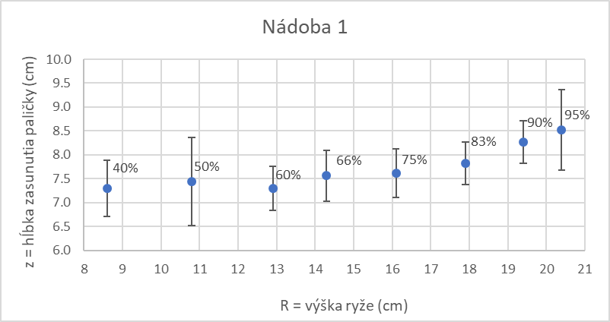
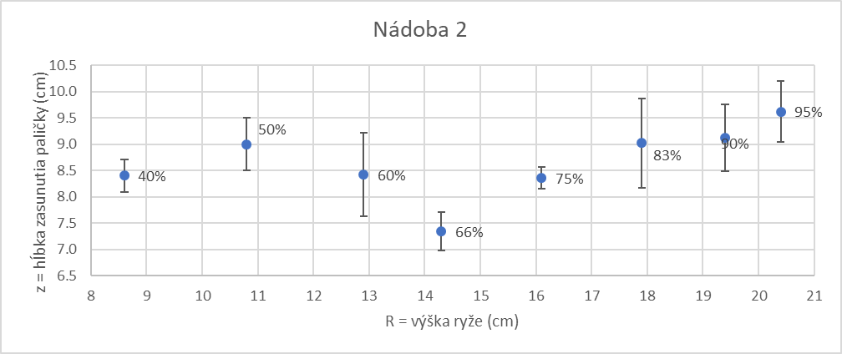
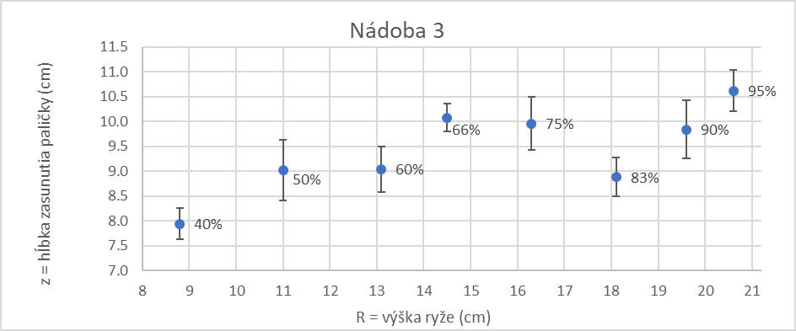
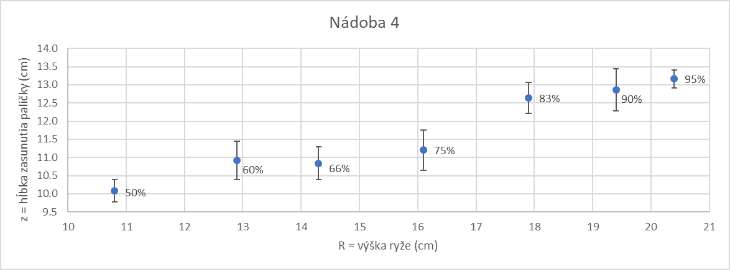
Researched parameter: diameter of vessel
Vessel 1 (d = 4,72 cm, m= 14 g); Vessel 2 (d: 5,12 cm, m = 14 g); Vessel 3 (d = 5,94 cm, m = 17 g);
Vessel 4 (d = 7,06 cm, m = 29 g); Vessel 5 (d = 9,42 cm, m = 43 g); Height = 21,5 cm

Slide 27
Researched parameter: diameter of vessel
Vessel 1 (d = 4,72 cm, m= 14 g); Vessel 2 (d: 5,12 cm, m = 14 g); Vessel 3 (d = 5,94 cm, m = 17 g);
Vessel 4 (d = 7,06 cm, m = 29 g); Vessel 5 (d = 9,42 cm, m = 43 g); Height = 21,5 cm

Slide 28
Researched parameter: immersion spot
Phenomenon demonstration
Phenomenon explanation
Theory
Measurements
Results
Vessel: Diameter = 9,42 cm; Weight = 43 g; Height = 21,5 cm

Slide 29
Researched parameter: immersion spot
Phenomenon demonstration
Phenomenon explanation
Theory
Measurements
Results
Vessel: Diameter = 9,42 cm; Weight = 43 g; Height = 21,5 cm

Slide 30
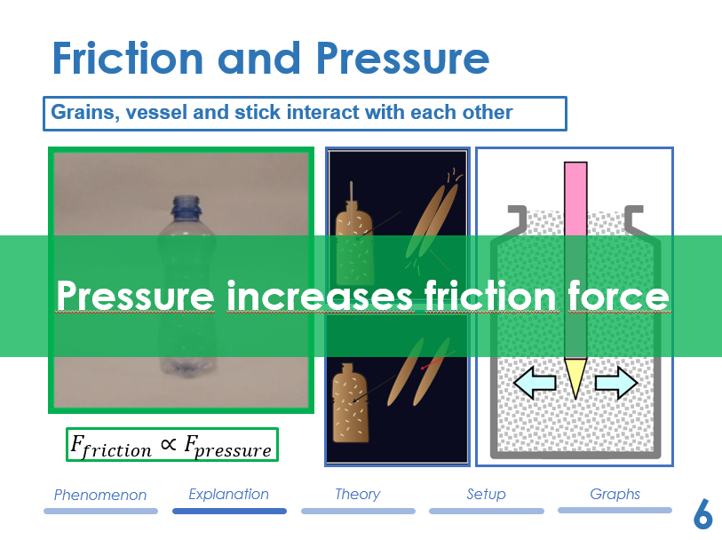
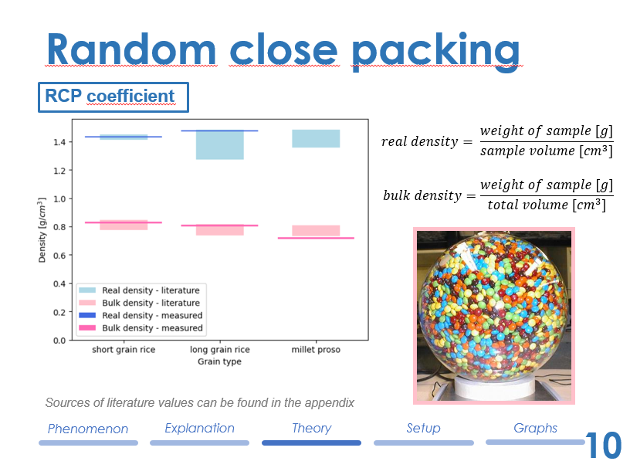
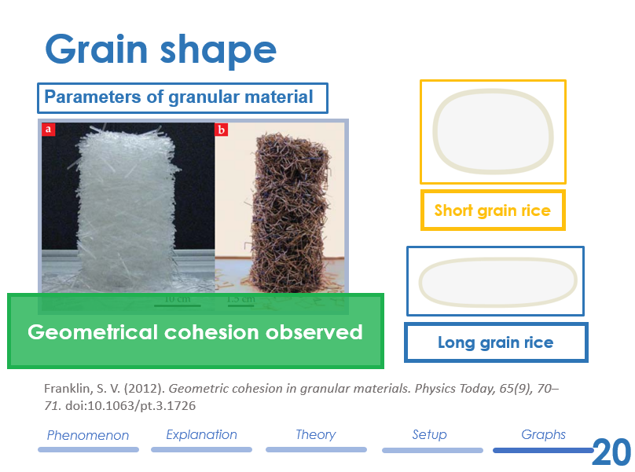
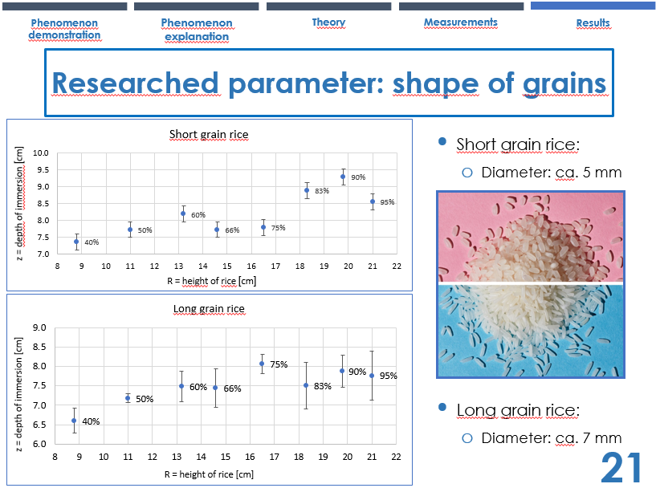

Slide 32
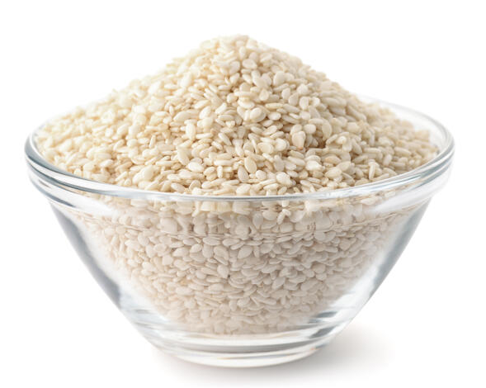
RCP calculations
Phenomenon demonstration
Phenomenon explanation
Theory
Measurements
Results
Kshirod R. Bhattacharya - Rice Quality: A Guide to Rice Properties and Analysis
Tiwari V. K, Ansari N. P, Asati A, Madhusudhan. Studies of Geo-gravimetric Properties of Polished Rice, Oryza Sativus, (Pusa Sugandha-1). Biosc.Biotech.Res.Comm. 2019;12 (1).
K. R. Bhattacharya, C. M. Sowbhagya, Y. M. Indudhara Swamy: Some physical properties of paddy and rice and their interrelations
Mir, S. A., Bosco, S. J. D. and Sunooj, K. V. : Evaluation of physical properties of rice cultivars grown in the temperate region of India, Department of Food Science and Technology, Pondicherry University, Kalapet, 2013
Manjot Singh, Akinbode Adedeji, Dipak Santra: Transactions of the ASABE. 61(3): 1165-1174. (doi: 10.13031/trans.12553) @2018
Kirankumar M, S Anandakumar, Atchaya PT: Effect of moisture content on physical properties of proso millet (Panicum miliaceum L.)

Slide 33
Cardboard vessel
Plastic vessel
* Granular material: Millet proso
* Length of stick: 24,4 cm
* Material of vessel: cardboard
* Height of vessel: 22 cm
* Diameter of vessel: 4 cm
* Weight of vessel: 14 g
* Granular material: short grain rice
* Length of stick: 23,8 cm
* Material of vessel: plastic
* Height of vessel: 22 cm
* Diameter of vessel: 4,8 – 6,2 cm
* Weight of vessel: 15 g
‹#›
Notes:
Bimetallic strip
consists of 2 different metals
Ex. Steel & brass

Slide 34
Methods of obtaining results (RP)
Determination of amounts of granular material
Pouring material into containers while continuously tapping and measuring the height of the material
Finding the lower limit by repeatedly immersing the stick
Repetition at several heights of material and different containers
Processing and averagining results
Processing into graphs

Slide 35
Methods of obtaining results (RCP)
Determination of material weight and water volume
Pouring the material into a measuring cylinder filled with water. Shake to remove as much air bubbles as possible.
Observing the change in water level
Pouring a certain amount of material into a dry measuring cylinder and repeatedly observing the volume
Calculating different results using experimentaly obtained values
Comparison with the results of scientific researches

Slide 36
Phenomenon demonstration
Phenomenon explanation
Theory
Measurements
Results
Type of material | Density type | Data from scientific research |  | Data from my experiments
Short grain rice |  | 1 | 2
 | Real density [g/ml] | 1,41256 | 1,452 | 1,42857
 | Bulk density [g/ml] | 0,798 | 0,777 – 0,847 | 0,8333
 | Porosity | 0,434 | 0,41 – 0,46 | -0,19
 | Packing density | 0,566 | 0,54 – 0,59 | 1,19
Short grain rice |  | 3
 | Real density [g/ml] | 1,27081 – 1,48442 |  | 1,481
 | Bulk density [g/ml] | 0,73649 – 0,81785 |  | 0,812
 | Porosity | 0,4106 – 0,467 |  | -0,2
 | Packing density | 0,533 – 0,5894 |  | 1,2
Millet proso |  | 4 | 5
 | Real density [g/ml] | - | 0,1356192 – 0,148497 | 1,111
 | Bulk density [g/ml] | 0,76549 – 0,80967 | 0,756835 – 0,731414 | 0,723
 | Porosity | 0,4249 – 0,442 | 0,4419 – 0,5074 | 0,197
 | Packing density | 0,558 – 0,5751 | 0,4926 – 0,5581 | 0,803

Slide 37
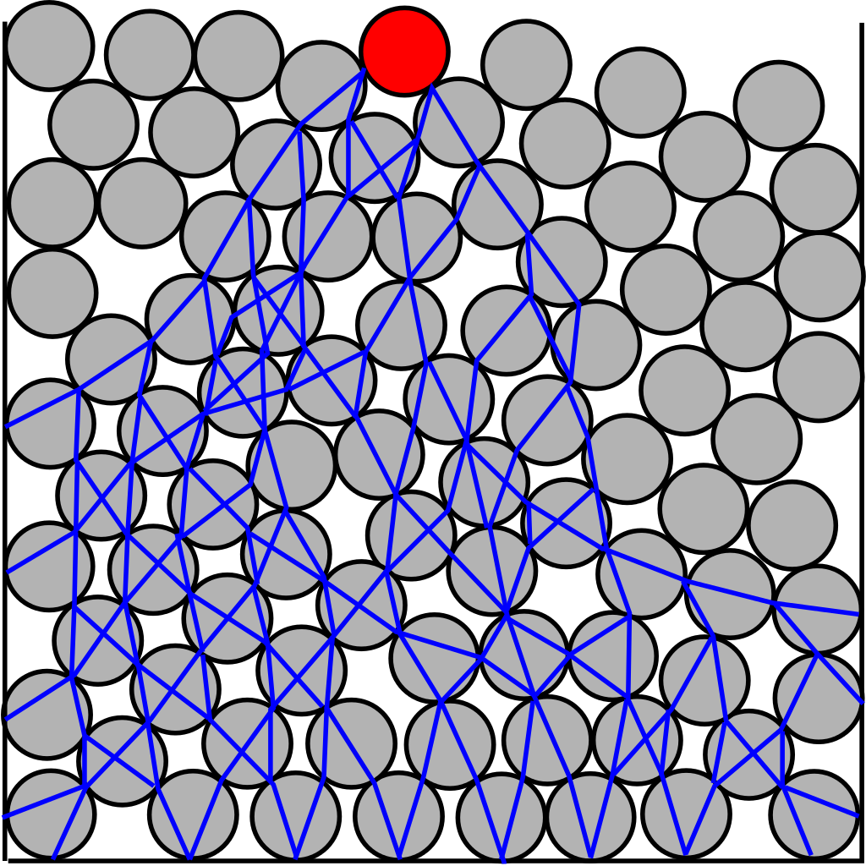
Traction chains network
Force chains visualize intermolecular forces
Emerging by the complex interaction of individual grains under stress exerted on the granular material
Claudia Cogné, Emmanuel Bellenger, Mohamed Guessasma, Christine Pélegris, Nabil Ferguen: A numerical model for predicting effective thermal conductivities of alumina/Al composites
https://en.wikipedia.org/wiki/Force_chain#cite_ref-Kondic2012_2-0
Daniel N. Wilke: Traction chain networks: Insights beyond force chain networks for non-spherical particle systems
Kondic, L.; Goullet, A.; O'Hern, C. S.; Kramar, M.; Mischaikow, K.; Behringer, R. P. (2012). "Topology of force networks in compressed granular media". EPL. 97 (5): 54001.

Slide 38
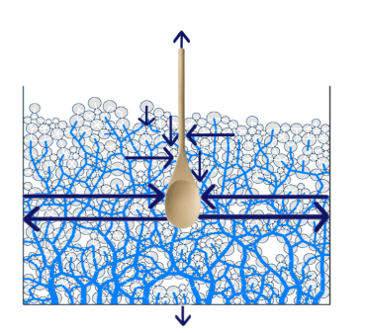

Actions of forces in granular material
Phenomenon demonstration
Phenomenon explanation
Theory
Measurements
Results
P
P
P
P
P
P
Jan Kleinert: Simulating Granular Material using Nonsmooth Time-Stepping and a Matrix-free Interior Point Method
Peters, J. F.; Muthuswamy, M.; Wibowo, J.; Tordesillas, A. (2005). "Characterization of force chains in granular material". Physical Review E. 72 (4 Pt 1): 041307.
Tomaso Aste, Tiziana Di Matteo, Enrico Galleani d´Agliano: Stress transmission in granular materials
https://web.physics.ucsb.edu/~complex/research/granular.html#ForceNumber

Slide 39
RCP – Random close packing
A parameter determining the maximum density of randomly arranged solid objects
The more we shake » the grater the density (e.g. during transportation)
Not possible infinitely, limit = RCP
Effect of object shape:
  polydisperse grains can be arbitrarily close to 1
  (relatively) monodisperse grains – shape plays a big role
  (RCP of spheres = 0,64; RCP of M&M´s candy = 0,68)
https://en.wikipedia.org/wiki/Random_close_pack

Slide 40
RCP calculations
Kshirod R. Bhattacharya - Rice Quality: A Guide to Rice Properties and Analysis
Tiwari V. K, Ansari N. P, Asati A, Madhusudhan. Studies of Geo-gravimetric Properties of Polished Rice, Oryza Sativus, (Pusa Sugandha-1). Biosc.Biotech.Res.Comm. 2019;12 (1).
K. R. Bhattacharya, C. M. Sowbhagya, Y. M. Indudhara Swamy: Some physical properties of paddy and rice and their interrelations
Mir, S. A., Bosco, S. J. D. and Sunooj, K. V. : Evaluation of physical properties of rice cultivars grown in the temperate region of India, Department of Food Science and Technology, Pondicherry University, Kalapet, 2013
Manjot Singh, Akinbode Adedeji, Dipak Santra: Transactions of the ASABE. 61(3): 1165-1174. (doi: 10.13031/trans.12553) @2018
Kirankumar M, S Anandakumar, Atchaya PT: Effect of moisture content on physical properties of proso millet (Panicum miliaceum L.)

Slide 41
RCP of several granular materials
Phenomenon demonstration
Phenomenon explanation
Theory
Measurements
Results
Type of material | Density type | Data from scientific research |  | Data from my experiments
Short grain rice |  | 1 | 2
 | Real density [g/ml] | 1,41256 | 1,452 | 1,42857
 | Bulk density [g/ml] | 0,798 | 0,777 – 0,847 | 0,8333
Long grain rice |  | 3
 | Real density [g/ml] | 1,27081 – 1,48442 |  | 1,481
 | Bulk density [g/ml] | 0,73649 – 0,81785 |  | 0,812
Millet proso |  | 4 | 5
 | Real density [g/ml] | - | 0,1356192 – 0,148497 | -
 | Bulk density [g/ml] | 0,76549 – 0,80967 | 0,731414 – 0,756835 | 0,723
Measuring cylinder –» deviation 0,5 ml
Weighting scale –» deviation 0,005 g

Slide 42
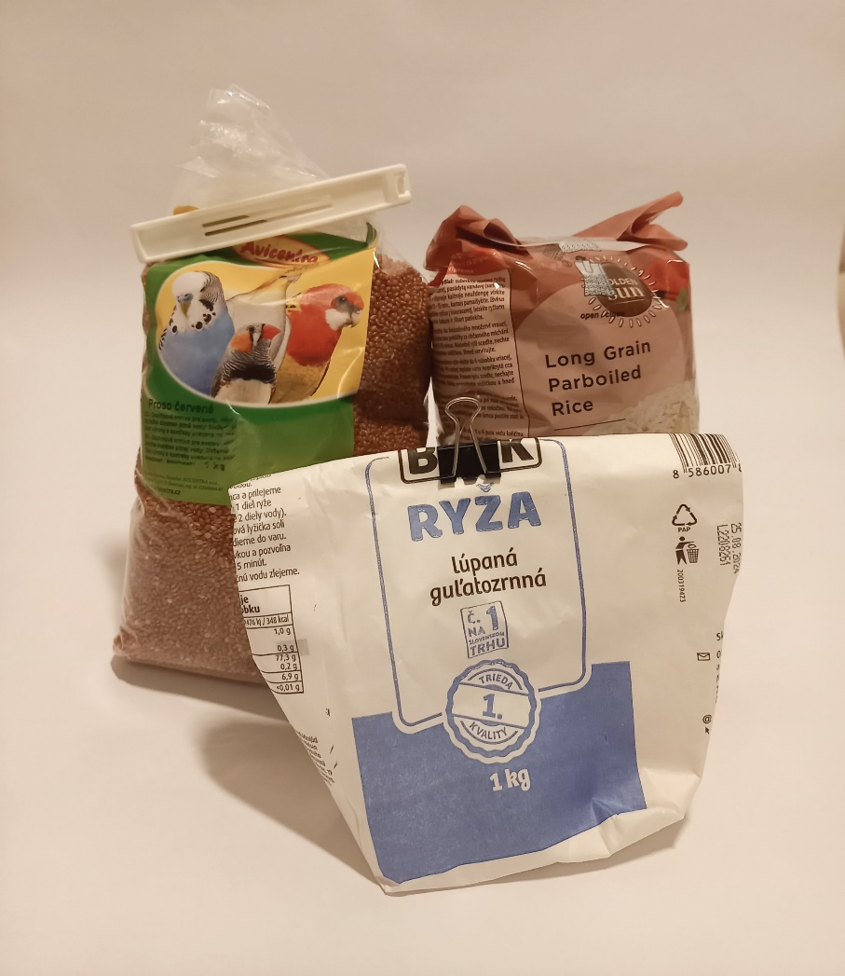
Experimental apparatus
Various granular materials (millet proso, short grain rice,
long grain rice)

Slide 43
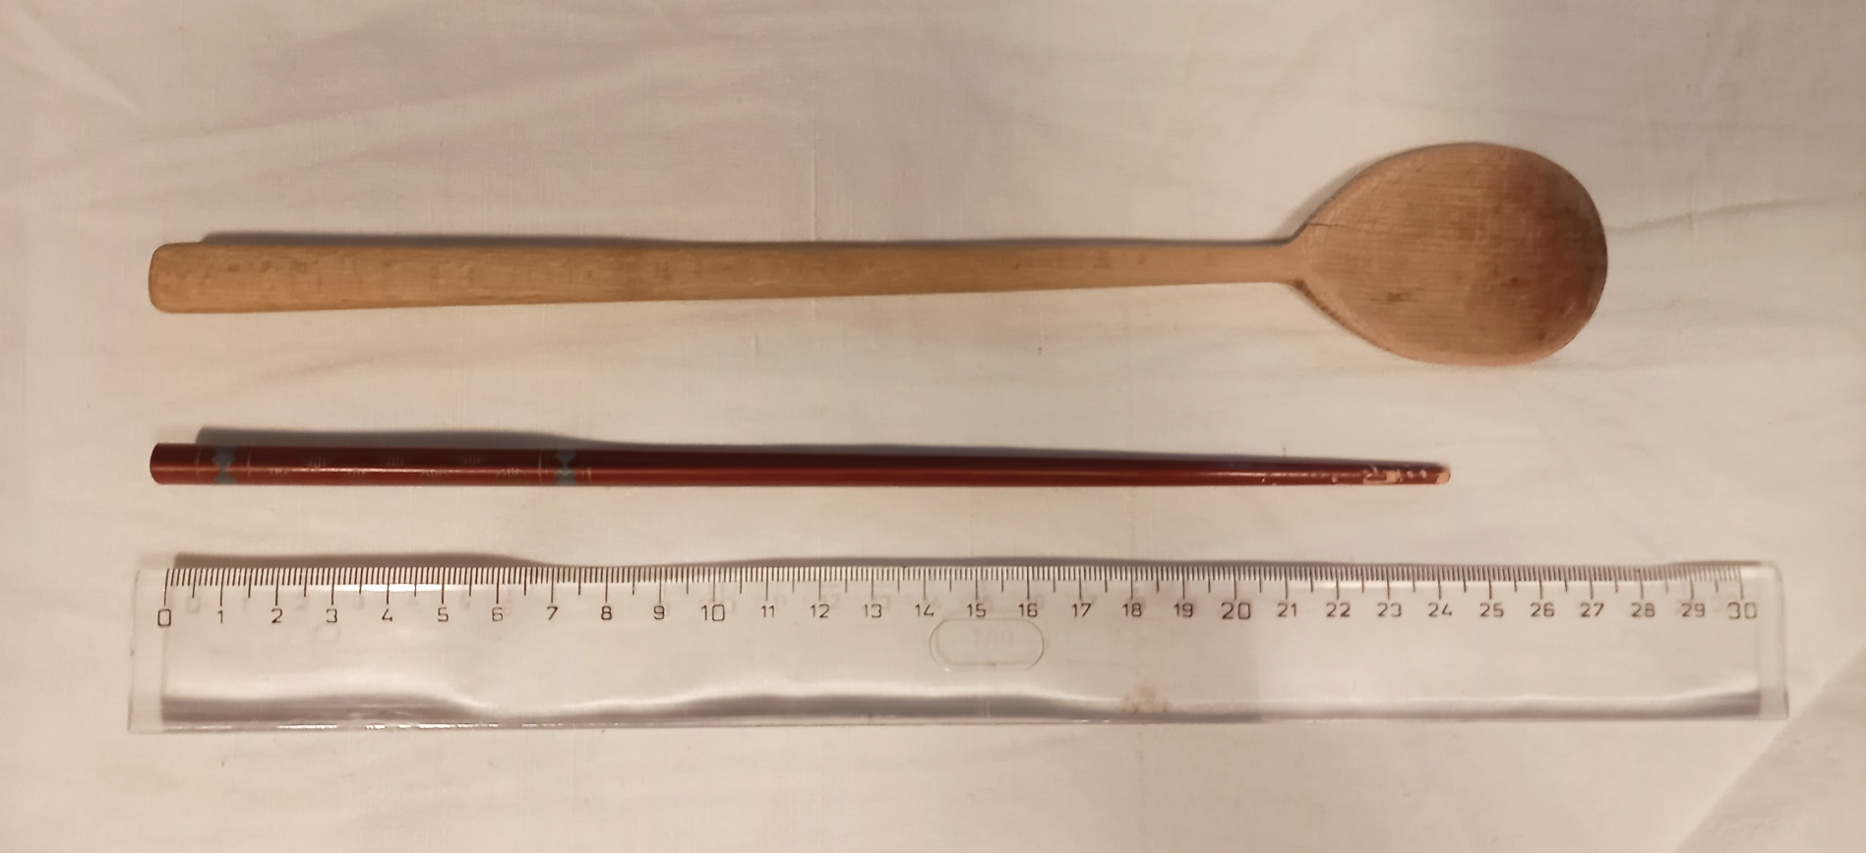
Experimental apparatus
Chopstick
Cooking spoon

Slide 44
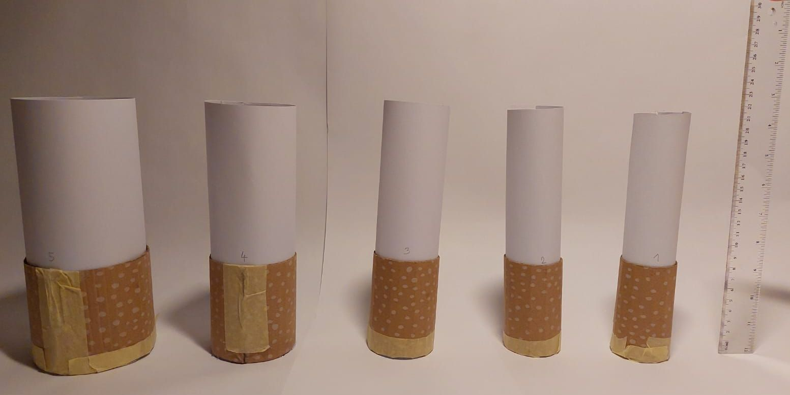
Experimental apparatus
7 different vessels
(by weight, width and height)

Slide 45
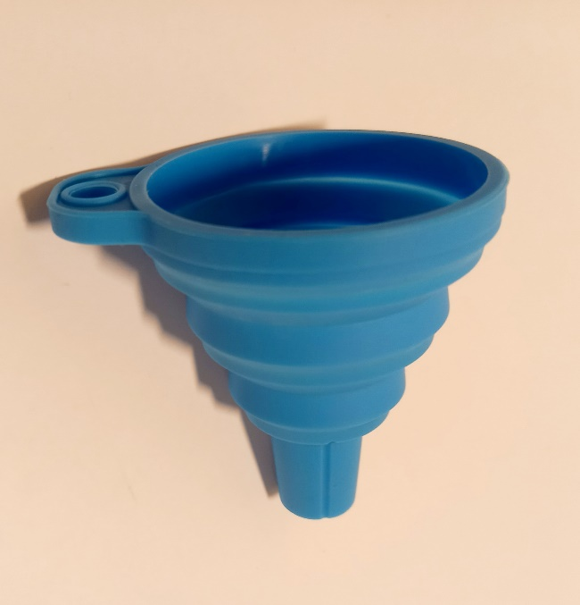
Experimental apparatus
Funnel
Weighting scale
Ruler
Measuring cylinder

Slide 46

Relevant parameters
Shape of gran. material
Surface of gran. material
Packing of gran. material
Amount of gran. material
Shape of spoon
Weight of vessel
Diameter of vessel
Depth of immersion
Distance between immersion spot and edge of vessel

Slide 47
Methods of processing results

